Slide 1

Polish Used Car Market
Hamed Ahmed Hamed Ahmed
Daniela Quintero Narváez

Slide 2

CONTENTS
Problem Statement
Methods and Tools
Dataset Description
Transportation
Logistics
Application
Conclusion
Trends, Challenges and Opportunities

Slide 3

Problem Statement
We need to develop a dashboard for our investor (my father) to monitor used car sales in Poland using data from the Otomoto website.
The goal is to provide insights into the Polish used car market to facilitate informed decision-making and capitalize on emerging opportunities between Poland and Egypt

Slide 4

Methods and Tools!
Web Scraping Dataset
EDA
Power BI
Machine learning Model
Python: Flask
Web App

Slide 5
Dataset Description
Dataset size: (+80k )
Dataset Source:
Feature | Type | Values
Offered by | category | (Private, Company)
Car brand | category | (Skoda, BMW, Ford, Mercedes-Benz ,..)
Production year | int | (2000, 2001, 2002, ……, 2023)
Fuel type | category | (Diesel, Gasoline, Hybrid, Electric)
Transmission | category | (Manual, Automatic)
Body type | category | (Sedan, Coupe, SUV, Kabriolet, ….)
Price | int | (4000, 6000, 8000, 20000, ….)
Engine | int | (1458, 1342, 1982, …)
Mileage | int | (20000, 30000, 49000, 88000)

Slide 6
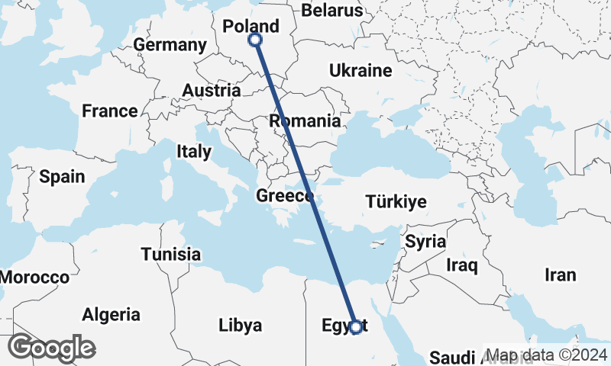
Transport
Duration : 2 - 3 Months

Slide 7
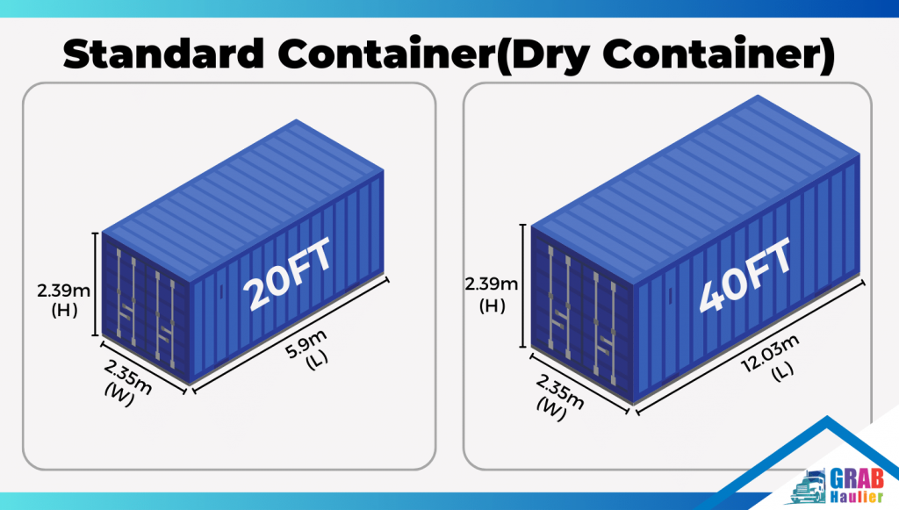
Logistics
20ft price: 500$ - 800$
40ft price: 1000$ - 1500$

Slide 8
Models
Model | Train R2-score | Test R2-score | Validation R2-score
Linear Regression | 0.9 | -4.233884e+16 | -1.270279e+16
Random Forest | 0.78 | 0.77 | 0.76
Lasso Regression | 0.87 | 0.87 | 0.81
Ridge Regression | 0.9 | 0.9 | 0.85
Gradient Boosting | 0.92 | 0.91 | 0.88
XGBoost | 0.93 | 0.92 | 0.9
TensorFlow NN | 0.927 | 0.916 | 0.85
PyTorch NN | 0.937 | 0.913 | 0.84

Slide 9

Application

Slide 10

Thank You

